Slide 1
Database
API
UI Architecture
and Customer Delight
Josh Harrison, OTX Winc Wranglers

Slide 2
DISCLAIMER
This IS NOT a demo to help prove or support the value of accessibility.

Slide 3
DISCLAIMER
This IS NOT a demo to help prove or support the value of accessibility.
This IS a demo to prove that UI architecture is as important as DB and API architecture.

Slide 4
DISCLAIMER
This IS NOT a demo to help prove or support the value of accessibility.
This IS a demo to prove that UI architecture is as important as DB and API architecture. We just used accessibility to prove it.

Slide 5
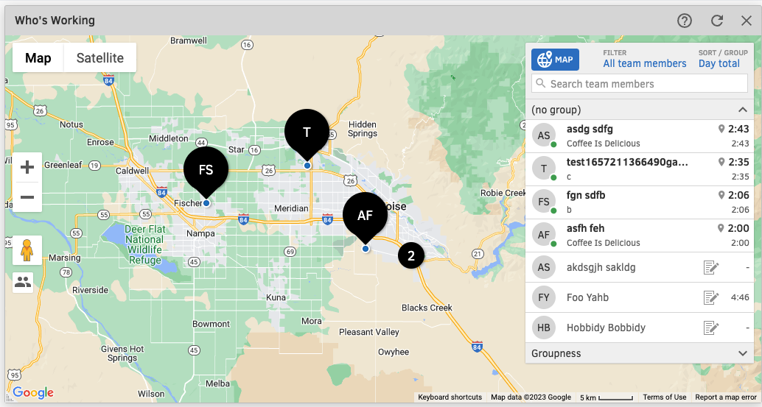
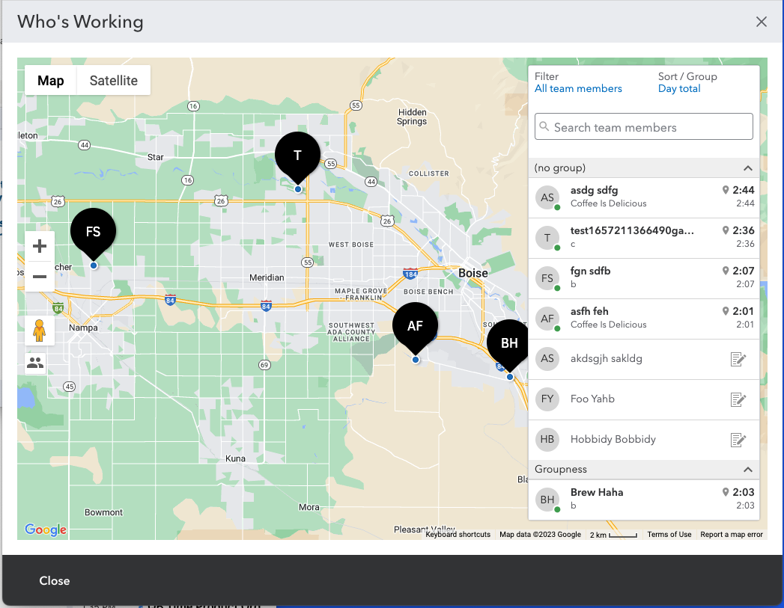
Notes:
The image on the left is the legacy feature that we will be rebuilding using a modern JavaScript framework and UI styles.
The image on the right is the updated feature as designed using our modern UI component library.

Slide 6
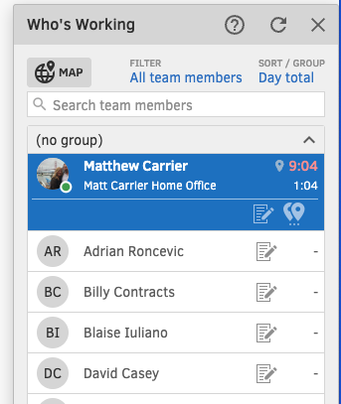
Notes:
This image illustrates the original feature and some interactive styles. This “list” is built using many divs and spans for layout and clickable text elements.

Slide 7
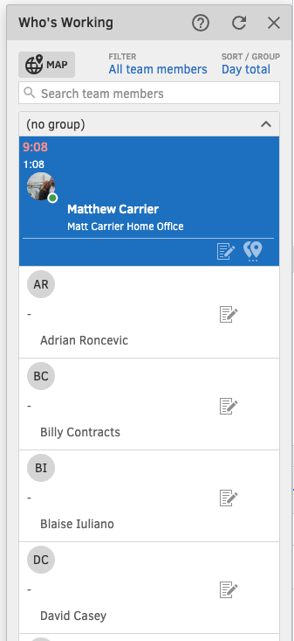
Notes:
The image on the right shows the original feature with many of they styles removed. This is to illustrate the structure of the HTML as it is written in the DOM and read aloud by a screen reader.

Slide 8

Brandon: “There’s no sem[antics], there’s no information to tell me what I’m seeing here.”
Brandon: “I just, kind of, can guess.”
Ted: “That could easily be an unordered list…”
Brandon: “It should be a table…”
Notes:
A customer interview video where the customer describes how confusing the list is to navigate with a screen reader. The legacy list does not provide any structure and the text is completely out of order and without context. The customer believes this should be built as a table while our accessibility leader believes it should be built as an unordered list.
Video cannot be shared publicly due to IP.

Slide 9
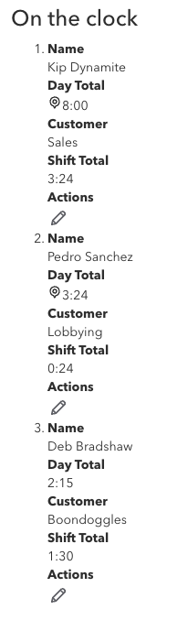
Notes:
This image shows an ordered list (no styling applied) using a definition list to define terms and values. Refer to “Semantic DL.mov” in the “Experiment Videos” for the demonstration.

Slide 10
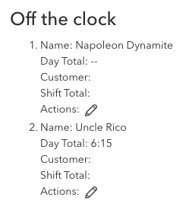
Notes:
This image shows an ordered list (no styling applied). Refer to “Semantic OL.mov” in the “Experiment Videos” for the demonstration.

Slide 11
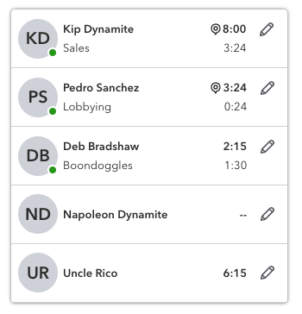
Notes:
This image shows the styled list. Refer to “Styled DL.mov” and “Styled OL.mov” in the “Experiment Videos” for the demonstrations.

Slide 12
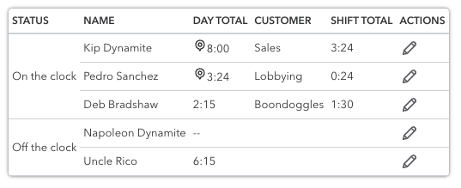
Notes:
This image shows a structured table (no styling applied). Refer to “Semantic Table.mov” in the “Experiment Videos” for the demonstration.

Slide 13
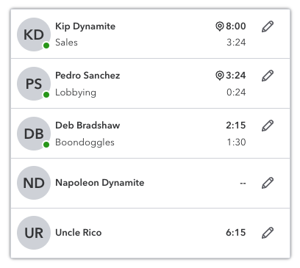
Notes:
This image shows a styled table. Refer to “Styled Table.mov” in the “Experiment Videos” for the demonstration.

Slide 14
Lessons Learned
Visually delightful ≠ accessible
Notes:
Image illustrating a feature that meets all of the requirements of the design specification but was not built to meet the HTML specifications. This solution is not accessible to screen readers.

Slide 15
Lessons Learned
Visually delightful ≠ accessible
Accessible ≠ delightful experience
Building to spec ≠ delightful experience
Notes:
Supporting the point that all 3 of our examples are built to meet the HTML specifications and meet accessibility requirements, but the UX of each is drastically different. Understanding the differences between each experience helps inform the architectural guidance.

Slide 16
Lessons Learned
Visually delightful ≠ accessible
Accessible ≠ delightful experience
Building to spec ≠ delightful experience
Notes:
Supporting the point that all 3 of our examples are built to meet the HTML specifications and meet accessibility requirements, but the UX of each is drastically different. Understanding the differences between each experience helps inform the architectural guidance.

Slide 17

Forward-Thinking
UX
Dev
Notes:
Our organization has a gap that exists between UX and Dev. UX creates designs and then hands them off to Dev. Dev is very talented at replicating those designs into code, but this doesn’t guarantee that the code meets specifications and user experience requirements.

Slide 18
Forward-Thinking
X
UX
Dev

Slide 19
Forward-Thinking
UI Architecture between Design and Dev
Proof-of-Concepts between Design and Dev
UI Coaching between Design and Dev
✔
UX
Dev
Notes:
We need to spend more time sitting in between UX and Dev, asking questions that align with user expectations and technical specifications. This way we can answer technical feasibility questions early and architect experiences that meet both sides of the requirements.

